Slide 1
IS216 Web Application Development II
Week 5
JavaScript – Part 3 (APIs, Axios, JSON)
K. J. Shim
Sections: G3/G4
https://tinyurl.com/is216-krazy-2024-js-part3

Slide 2

Source Code Files
eLearn → Content → Week 5 → Before Class → Week5.zip
Unzip it into your webroot (any meaningful sub-directory), for example:
(WAMP) C:\wamp64\www\is216\...\Week5
(MAMP) /Applications/MAMP/htdocs/is216/…/Week5
Visit web pages (.html) via HTTP protocol
Do NOT double-click on the HTML file. Your computer will open the HTML file as a file.
→ OH NO…
Open web pages via HTTP protocol. How? Go to the web browser’s address bar
→ GOOD

Slide 3
Topics
Asynchronous HTTP Requests
JSON Data Processing
Google Map APIs
Firebase Database

Slide 4
Asynchronous HTTP Requests

Slide 5
What is Asynchronous Request?
Asynchronous requests can be used to:
read data (e.g. JSON, XML, Text) from backend server - after the page has loaded
update a web page without reloading the page
send data to the server - in the background
Compared to Synchronous requests (e.g. requests sent via HTML Forms),
less data usage, faster, more interactive

Slide 6
Axios
Promise based API for sending Asynchronous HTTP requests to backend server / REST endpoints and doing create/read/update/delete (CRUD) operations
Can be used with plain JavaScript or with frameworks like Vue.js
What is promise-based?
Shortly.
Notes:
XML or JSON or Text: all very common

Slide 7
Basic Axios Methods
Basic Axios Methods
axios.get(url[, config])
axios.post(url[, data[, config]])
Axios Response Object
After sending an async. request, server returns a response.
Axios response object consists of:
data – payload
status – HTTP code (2xx, 3xx, 4xx)
statusText – HTTP status message (‘OK’, ‘Moved Permanently’, ‘Client Error’)
headers – information about the response, e.g. content type, cookies, etc.
Notes:
https://www.w3schools.com/tags/ref_httpmessages.asp

Slide 8
How Does Axios Work?
import AXIOS library
execute GET/POST request to the endpoint of your backend server
use the then method to act on the response result
Example: wk5example1.html
<script src="https://unpkg.com/axios/dist/axios.min.js"></script>
<button type="button" onclick="getAdvice()">Click Me!</button>
<script>
function getAdvice() {
axios.get(url)
.then(response => {
// process response.data object
})
.catch(error => {
// process error object
});
}
</script>

Slide 9
How Does Axios Work?
Sending GET requests with parameters
Example: wk5example2.html
axios.get(url, {
params: {
name1 : value1,
name2 : value2
}
})
.then(response => {
// process response.data object
})
.catch(error => {
// process error object
});

Slide 10
How Does Axios Work?
Sending POST requests with parameters
Example: wk5example3.html
axios.post(url, {
name1 : value1,
name2 : value2
})
.then(response => {
// process response.data object
})
.catch(error => {
// process error object
});

Slide 11
Javascript Arrow Functions
Arrow functions allow us to write shorter function syntax.
An arrow function is a function which has no name and is used once only.
Example
function onceFunc (msg) {
return "Hello World!" + msg;
}
Is equivalent to
msg => {
return "Hello World!" + msg;
}

Slide 12
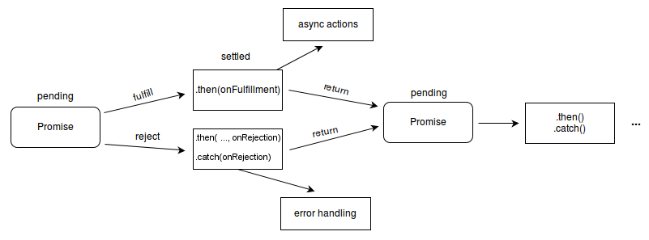
Promise
In Javascript, a Promise is an object used as a proxy for a value not yet known (similar to Future in Java).

Slide 13
then() and catch()
Given a Promise object x,
x.then(fn) executes the function fn if the x is in a fulfilled state; and returns another Promise object; otherwise x is returned.
x.catch(fn) execute the function fn if x is in a rejected state; and returns another Promise object; otherwise x is returned.
Example: wk5example1.html
//returns a promise
axios.get('http://api.adviceslip.com/advice')
//call then to handle the good case
.then(response => {
console.log(response.data.slip.advice)
})
//call catch to handle the bad case
.catch(error => {
console.log(error.message)
})

Slide 14
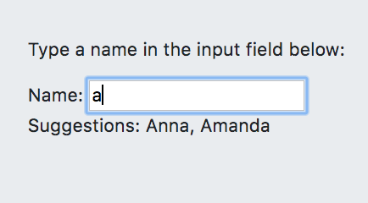
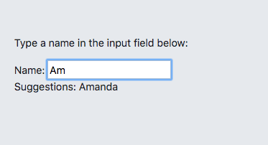
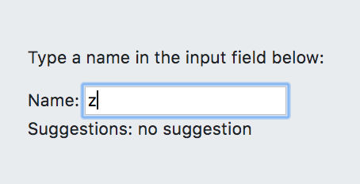
Exercise 1: Search
Given the resources: search.html, getHint.php (endpoint that returns Text data)
Modify search.html such that when a user types a character in the input field (onkeyup event), a function called showHint() is executed, which suggests the possible names that the user is searching for.
showHint() uses Asynchronous GET request to getHint.php to obtain those possible names

Slide 15
JSON

Slide 16
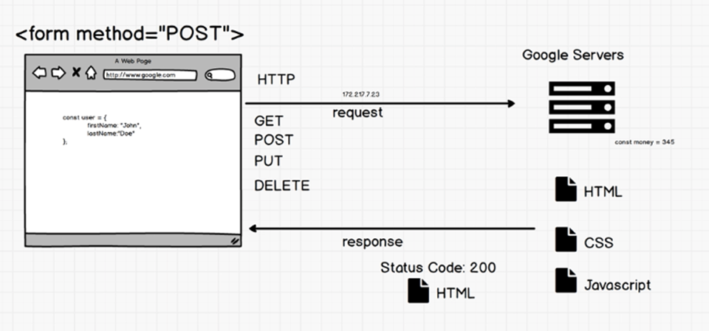
Why JSON?
You can’t just send JS objects directly to servers. Servers only understand Text. JSON or XML can be used to transfer data in text format.

Slide 17
JSON
Example:
{
"coord": { "lon": 139,"lat": 35},
"weather": [
{
"id": 800,
"main": "Clear",
"description": "clear sky",
"icon": "01n"
}
],
"base": "stations",
…
}
What is JSON?
Lightweight data-interchange format for storing and exchanging data.
JSON has a JavaScript syntax but is text only.
JavaScript values/objects can be converted into JSON and send it to the server; JSON received from the server can be converted into JavaScript values/objects.
Language independent; can be used by any programming language.

Slide 18
JSON Syntax
JSON objects are written in key/value pairs, separated by commas and surrounded by curly braces:
In JSON, keys must be strings, written with double quotes.
The file type for JSON files is ".json".
Example:
{
"name" : "Mary",
"age" : 26,
"hobby" : ["swimming", "badminton"],
"isMarried" : false
}

Slide 19
JSON Data Types
In JSON
There are 6 types: null, string, number, Boolean, JSON object, and array.
In Javascript
Function typeof returns 6 different values.
Object, boolean, function, number, string, and undefined
Example: wk5example4.html
{
“employee”: {
"name" : "Mary", "age" : 26,
"hobby" : ["swimming"],
"isMarried" : false
}
}
"..." is string
26 is a number
[...] is an array
false / true: boolean
{ … }: object
typeof([1,2,3]); // object!

Slide 20
Nested JSON
Nested Objects
person = {
"name":"John",
"age":30,
"cars": {
"car1":"Ford",
"car2":"BMW",
"car3":"Fiat"
}
}
Nested Arrays
person = {
"name":"John",
"Age":30,
"cars": [
{ "name":"Ford", "models":[ "Fiesta", "Mustang" ] },
{ "name":"BMW", "models":[ "320", "X3", "X5" ] },
{ "name":"Fiat", "models":[ "500", "Panda" ] }
]
}

Slide 21
JSON vs Form Data
Form Data
Typically, we exchange data between client and server using forms (<form> tag) in HTML via POST or GET request
But this is a synchronous activity – request/response protocol
JSON
With JSON, we can also now grab the contents of the <input> in a form and submit those with JSON instead of form data
You can submit to server whenever you want through Asynchronous HTTP requests

Slide 22
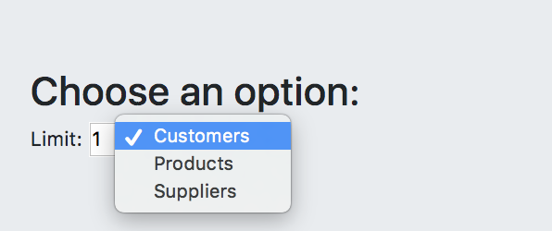
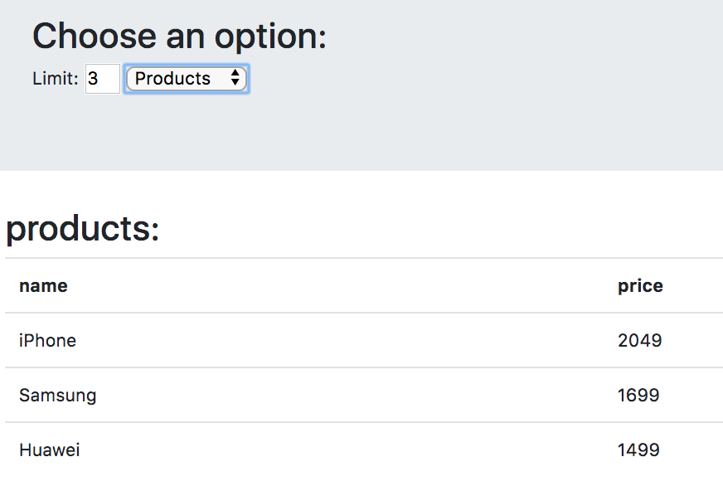
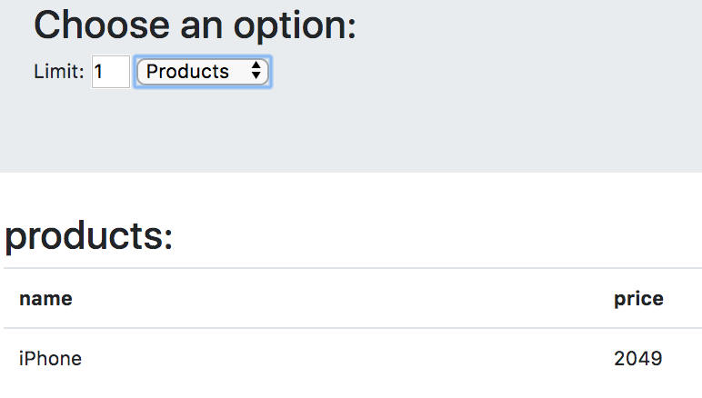
Exercise 2: Dynamic Table
Given the resources: info.html and getData.php (endpoint that returns JSON)
Modify info.html so that it generates the HTML table dynamically based on the value of a drop down menu and the limit value
Requirement: use Async. POST request to getData.php

Slide 23
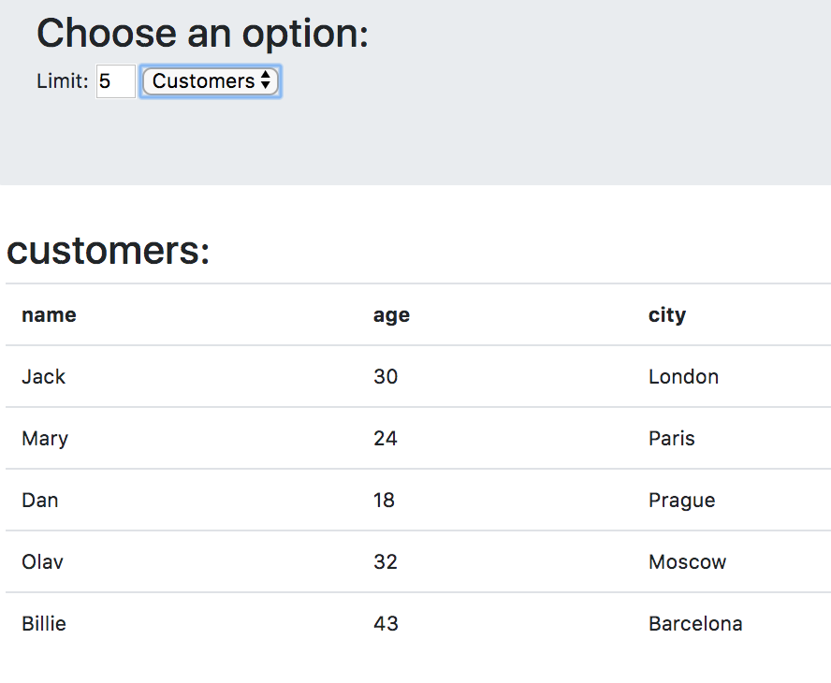
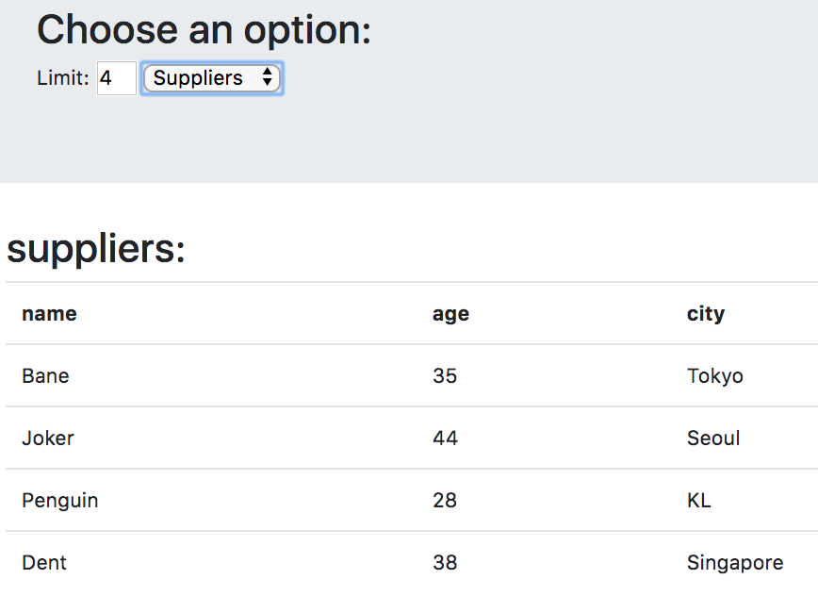
Exercise 2 ctd.
Modify info.html so that it generates the HTML table dynamically based on the value of a dropdown menu and the limit value:

Slide 24
Extra Exercise: A Blog Service
Given: blog/ folder containing several server files
Set up a blog service on your WAMP server.
Start your WAMP server
Import create.sql
Modify the password and port number accordingly in ConnectionManagement.php
Put the folder blog on your server
Username: “root”;
password is “” for windows; “root” for MAC);
Default port is: 3308 (or 3306)
Test Case
../REST/blog/getPosts.php
Open the above (customize the relative path according to where the blog folder is on your WAMP/MAMP server) and make sure some JSON data is received.

Slide 25
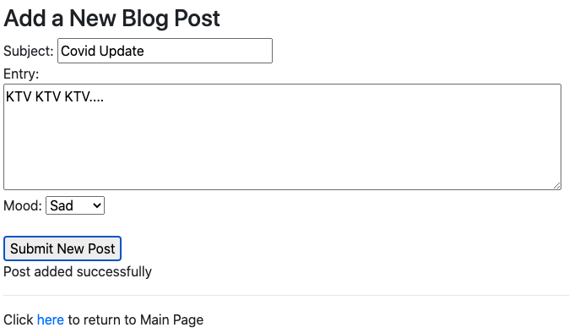
Extra Exercise: A Blog Service ct.
Complete the TODO in extra-addpost.html so that it uses the service provided by addPost.php to add a new blog post.

Slide 26
Using Google Map APIs

Slide 27
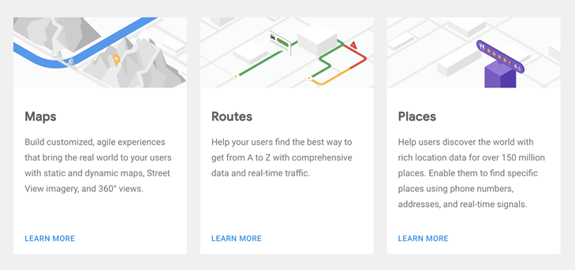
Google Map API
Google Map API
https://cloud.google.com/maps-platform/
API: Maps, Routes, Places, Gaming Solution and more
Google Maps JavaScript API V3 Reference

Slide 28
Google Map API
Let’s now take another look at the program that we did in Week 1.
Example
wk5example5.html

Slide 29
Geolocation and Google Map
The HTML Geolocation API is used to locate a user's position.
HTML Geolocation API
Geolocation API - Web APIs | MDN
Example: wk5example6.html
https://developers.google.com/maps/documentation/javascript/examples/map-geolocation#maps_map_geolocation-javascript

Slide 30
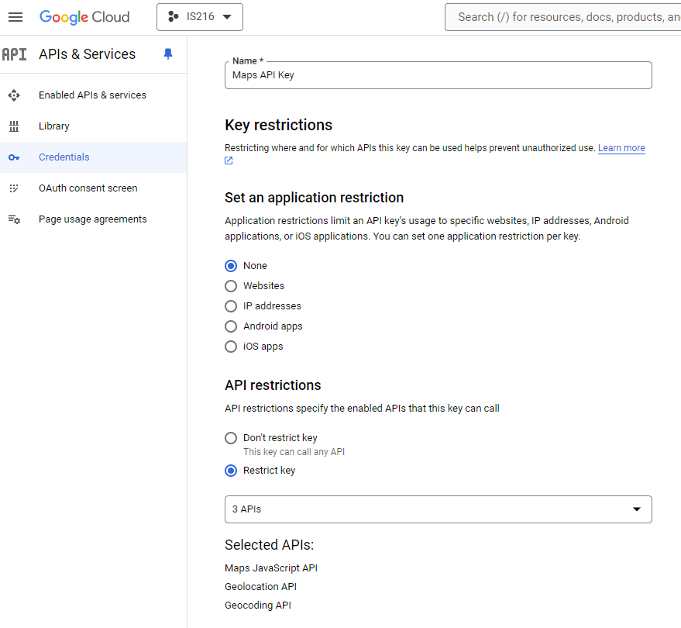
Exercise 3: Preparation
Enable Geocoding API.
Check your API key works using wk5example6.html
Try the following URL in your browser and make sure that some JSON data is received. Analyze the data a bit.
https://maps.googleapis.com/maps/api/geocode/json?address=1600+Amphitheatre+Parkway,+Mountain+View,+CA&key=yourapikey

Slide 31
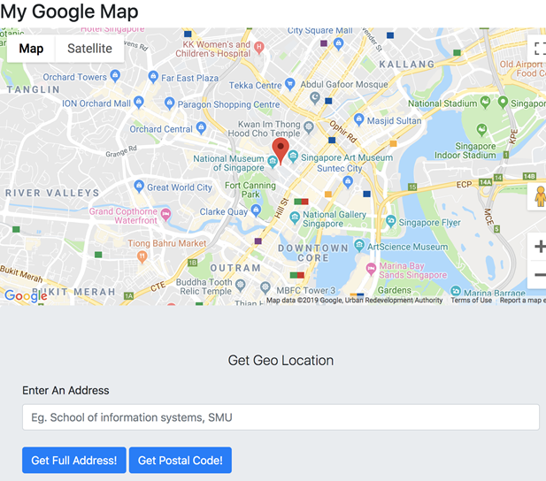
Exercise 3
Given ex3.html, implement a client app (for geoencoding) such that given a street address, the app should show its geolocation on the map and put a mark.
The app should make use of Google’s Geocoding API provided as web services.

Slide 32
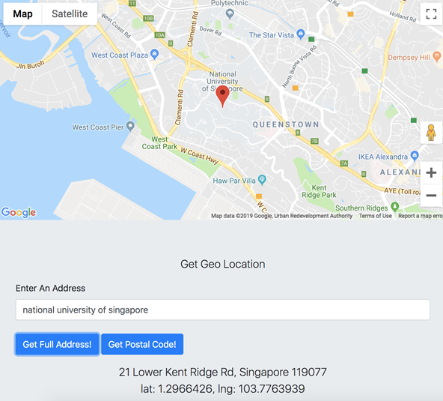
Exercise 3 (Cont’d)
On page load, the app shows a map with a marker at a default address
It has an input field where the user can either enter a partial address or a postal code.
Upon clicking the button, the app shows the corresponding information.
Also the map automatically refreshes to the new address that the user just provided.
Your code should properly deal with invalid addresses.

Slide 33
Take-Away Message
JSON - a structured text for server-client communication
Axios – send asynchronous HTTP GET/POST requests
axios.get( url, { params: { … } } )
.then( response => { … } )
.catch( error => { … } )

Slide 34
Questions? Need Help?
Join us in Slack
@
https://is216-oppa.slack.com
Thank You!

